Slide 1
Git por IDEs
PET-CC UFSM

Slide 2


IDEs que serão mostradas
Visual Studio Code
PyCharm Professional

Slide 3

VSCode

Slide 4

VSCode

Slide 5
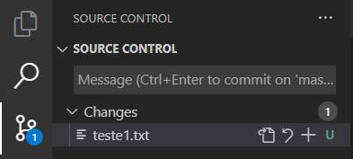
VSCode

Slide 6
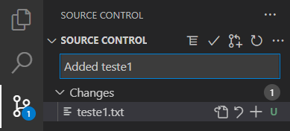
VSCode

Slide 7

VSCode

Slide 8
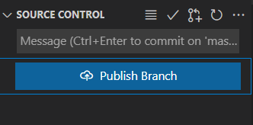
VSCode

Slide 9
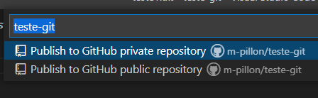
VSCode

Slide 10
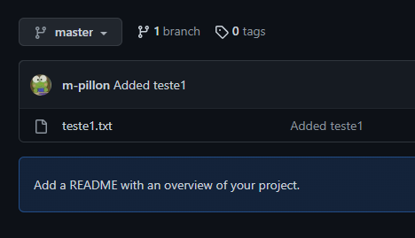
VSCode

Slide 11
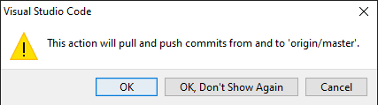
VSCode

